Slide 1


Slide 2

Group and Supervisor
Group Members:
Nasir Shahzad (SP22-BCS-077)
Sohail Faiz Rasool (SP22-BCS-095)
Supervisor:
Mr. Tanveer Ahmad
Institution:
COMSATS University Islamabad

Slide 3

BrainBee: Bridging the Education Divide
An AI-powered learning platform designed to transform education through personalization, gamification, and real-time progress tracking.

Slide 4
The Education Divide
Inequality in Access
Limited Parental Involvement:
Financial Barriers
Parents cannot check their child's progress
Overcrowded Classes
Parents cannot evaluate students' performance
Teacher-Student Ratio
Limited ability to support education
Lack of Personalized Feedback
This limits access to learning opportunities.

Slide 5
Proposed Solution: BrainBee
1
AI-Powered Learning
2
Gamification & Engagement
Personalized study plans adapt to each student's needs. The system offers instant feedback to accelerate learning.
Leaderboards and rewards boost student motivation. Peer challenges create a fun, competitive learning environment.
3
Parental & Teacher Support
Real-time progress tracking provides essential insights. Both parents and teachers gain visibility into learning outcomes.

Slide 6









TOOLS AND TECHNOLOGIES

Slide 7
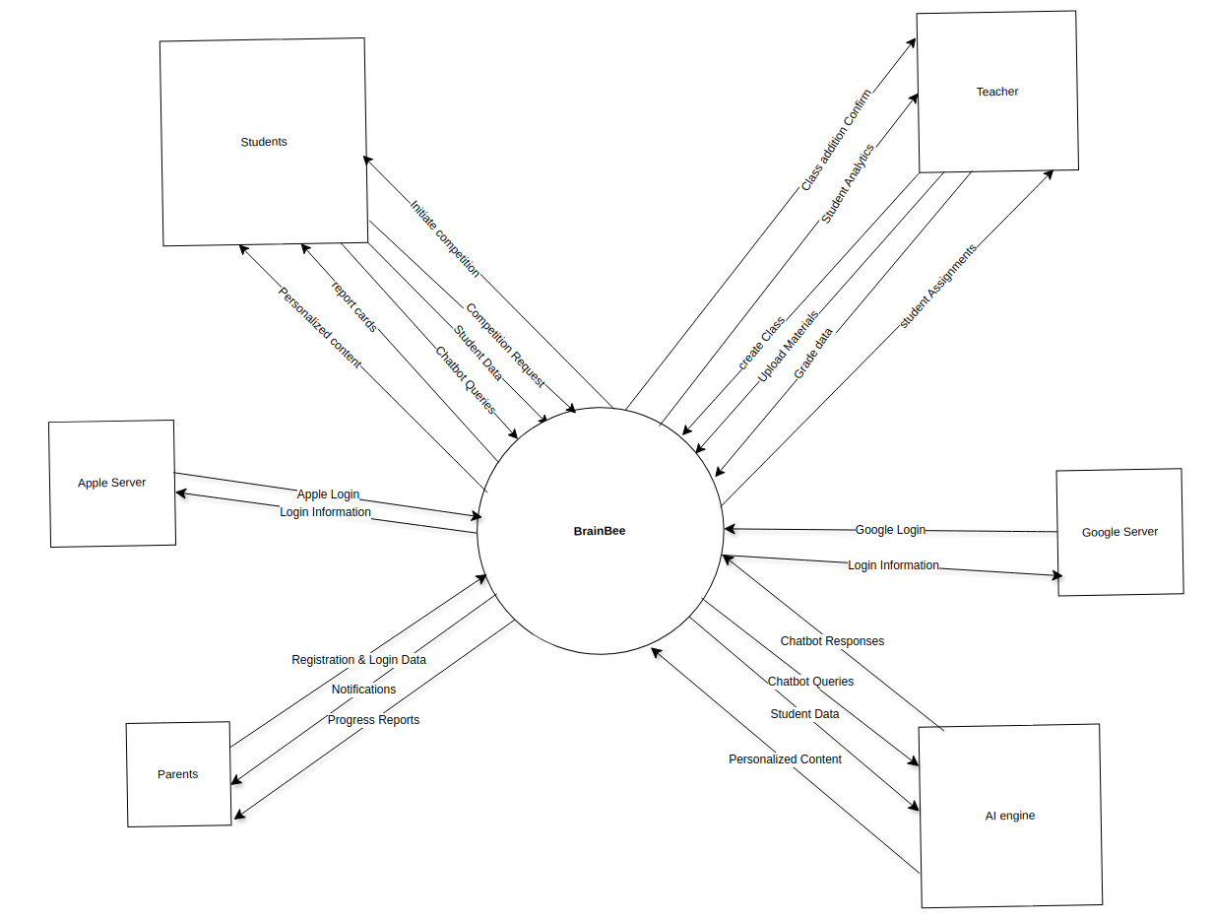
Context Diagram
System Components & Interactions:
Students: Start competitions, request new competitions, submit data, query chatbot, and receive report cards & personalized content.
Teachers: Create classes, upload materials, grade assignments, assign tasks, receive student analytics, and confirm class enrollments.
Parents: Register, log in, receive notifications, and access progress reports.
AI Engine: Processes chatbot queries, provides responses, analyzes student data, and delivers personalized content.
Google & Apple Servers: Authenticate users and manage login information through Google & Apple login.

Slide 8
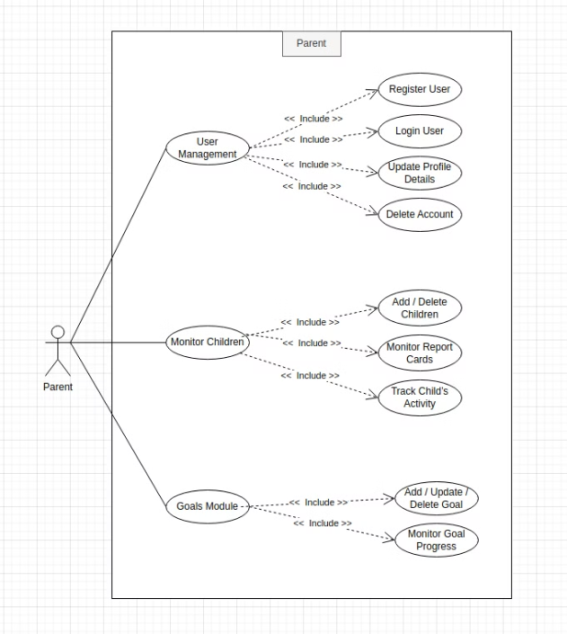
Use Case Diagram – Parent Module
Actor: Parent
Main Use Cases:
User Management: Register, login, update profile, and delete account.
Child Monitoring: Add/remove children, track report cards, and monitor activities.
Goal Management: Set, update, and track goal progress.
Purpose: Defines the parent's role in managing accounts, overseeing children's academic progress, and tracking goal achievements

Slide 9
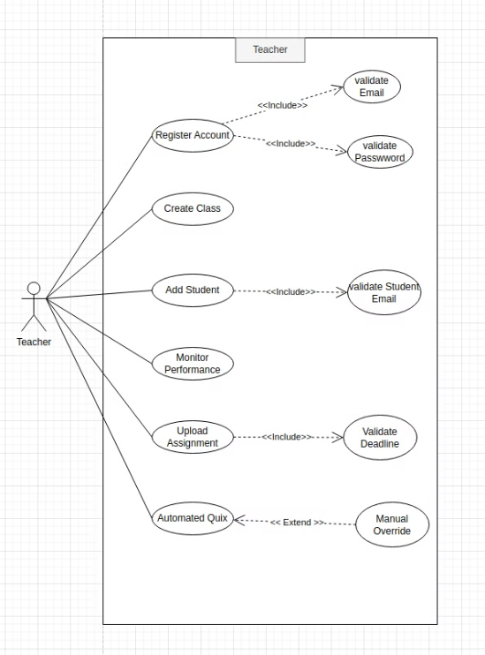
Use Case Diagram – Teacher Module
Actor: Teacher
Main Use Cases:
Register Account (Includes: Email & Password Validation)
Create Class
Add Student (Includes: Student Email Validation)
Monitor Student Performance
Upload Assignment (Includes: Deadline Validation)
Generate Automated Quizzes (Option for Manual Override)
Purpose: Depicts teacher interactions with the system and core functionalities.

Slide 10

BrainBee Modules
A Smart Learning Platform for Engaging Education

Slide 11
Student: User Management
1
User Accounts
2
Profile Customization
The system creates and manages user accounts for students and teachers.
Students can update their profile details and select subjects.
3
Grade Management
4
Progress Sharing
Teachers manage student grades within the module.
Users can share their learning progress with peers.

Slide 12
Student: Learning
5
AI-Powered Learning Tools
6
Interactive Chatbot Support
Personalized summaries adapt to your learning style. Flashcards are tailored for effective memorization.
Instant doubt clarification is available through the AI chatbot. Just select text for immediate assistance.
7
Comprehensive Class Management
8
Offline Accessibility
Access class materials, discussions, and key details effortlessly. Track grades and performance trends.
Download notes and worksheets for studying on the go. Learn anytime, anywhere, with or without internet access.

Slide 13
Student: Peer Competition
9
Engaging Peer Interaction
10
Enhanced Learning Experience
Promotes friendly competition with AI-generated quizzes and battles.
Students challenge each other with varied topics.
11
Community Features
Enables students to manage friends and track battle stats.

Slide 14
Student: Achievement and Rewards Module
12
Digital Recognition
13
Certificate Management
Students showcase their earned badges on personalized profiles. Achievements unlock as learners master specific educational milestones.
Digital certificates mark significant educational accomplishments. Students can view, download, and share their accolades with peers.
14
Reward Economy
15
Quest Participation
Earned coins create motivation through tangible benefits. Students redeem points for educational resources or special privileges.
Interactive challenges offer additional coin-earning opportunities. Quests encourage exploration beyond standard curriculum requirements.

Slide 15
Student: Performance Analytics Module
16
Comprehensive Score Tracking
17
Detailed Report Cards
Students access their academic progress at a glance. View overall performance metrics and detailed book-by-book analysis.
In-depth performance breakdowns for each educational resource. Identify strengths and areas for improvement with intuitive visual data.
18
Progress Leaderboards
19
Data-Driven Learning
Track performance rankings across multiple timeframes. Compare weekly, monthly, and yearly standings against peers.
Transform performance metrics into actionable insights. Make informed decisions about study habits and focus areas.

Slide 16
Student: AI Powered Assistant Module
20
Smart Academic Support
21
Continuous Learning
Our AI assistant provides instant answers to student questions. The model is trained specifically on course materials for accurate guidance.
The assistant improves with each interaction. It adapts to students' learning styles and common question patterns.
22
Conversation History
23
24/7 Availability
All chats are saved for future reference. Students can revisit previous explanations when studying for exams.
Learning happens anytime, so our AI assistant never sleeps. Get help with difficult concepts even outside school hours.

Slide 17
Parent Application

Slide 18
Parent: Monitor Children Module
1
Child Management
2
Academic Progress
Parents can easily add or remove children from their account. Track multiple students from a single dashboard.
Access detailed report cards for each book. View subject-specific performance metrics and completion rates.
3
Activity Tracking
4
Performance Reports
Monitor learning engagement in real-time. See time spent on different subjects and completed exercises.
Receive comprehensive weekly and monthly summaries. Get instant notifications when goals and quizzes are completed.

Slide 19
Parent: Goals Module
5
Goal Management
6
Progress Tracking
Parents can create, modify, and remove personalized academic goals for their children. Goals can be customized based on subjects or specific skills.
Real-time monitoring of children's advancement toward established goals. Visual progress indicators help both parents and children stay motivated.
7
Reward System
8
Achievement Timeline
Parents assign digital coins for completed goals. These rewards encourage continuous learning and achievement through positive reinforcement.
View history of completed goals and earned rewards. Celebrate learning milestones to build confidence and persistence.

Slide 20
Teacher Application

Slide 21
Teacher: Class Management Module
1
Classroom Organization
2
Content Management
Create multiple virtual classrooms with intuitive controls. Add or remove students with simple drag-and-drop functionality.
Upload and organize learning materials by subject or topic. Modify existing resources to keep content fresh and relevant.
3
Assessment Tools
4
Collaborative Features
Build customized quizzes using our template library. Create and distribute assignments with automatic grading capabilities.
Engage in classroom discussions through integrated messaging. Foster peer learning in a secure digital environment.

Slide 22
Teacher: Assessment Module
5
Performance Monitoring
6
AI-Powered Insights
Track individual student progress across all assignments and quizzes. View completion rates and identify learning gaps instantly.
Machine learning algorithms analyze student data to generate personalized reports. Receive actionable recommendations for each student's unique learning journey.
7
Custom Learning Paths
8
Real-Time Feedback
Design tailored educational experiences based on performance data. Adjust difficulty levels and content to match each student's abilities.
Identify struggling students before they fall behind. Intervene quickly with targeted support exactly when needed.

Slide 23

Non-Functional Requirements of BrainBee
Ensuring Quality, Security, and Performance for an optimal educational experience

Slide 24
Usability
1
Quick Adoption
2
User-Friendly Interface
95% of users navigate the interface within 5 minutes, ensuring immediate productivity.
Intuitive UI makes learning modules and quizzes instantly accessible, focusing students on learning.
3
AI Comprehension
4
Seamless Experience
Quiz system interprets 90%+ user queries correctly. Natural language enhances student-AI interaction.
Smooth navigation designed for all users ensures frustration-free platform engagement.

Slide 25
Performance
1
Quiz Generation
2
Resource Loading
3
Real-Time Updates
Quizzes must generate within 5 seconds. This ensures a smooth user experience.
Flasahcards, videos, and learning resources must load in 3 seconds.
User progress updates happen in real-time. It provides instant feedback.

Slide 26
Interoperability
1
File Format Support
2
Secure Communication
BrainBee supports JPG and PNG uploads. Students and teachers can easily share profile pictures and learning materials.
All API communication uses HTTPS protocols. This ensures data transfers remain protected and reliable.
3
Cross-Platform Compatibility
Standardized protocols enable integration with other educational tools. BrainBee works seamlessly with existing school systems.

Slide 27
Security
1
Password Encryption
2
Authenticated Access
3
Data Security
User passwords are encrypted before storage. This prevents unauthorized access to sensitive information.
Only authenticated users can access resources.
Student progress data is securely stored. This prevents tampering and breaches.

Slide 28
Functional Requirements

Slide 29
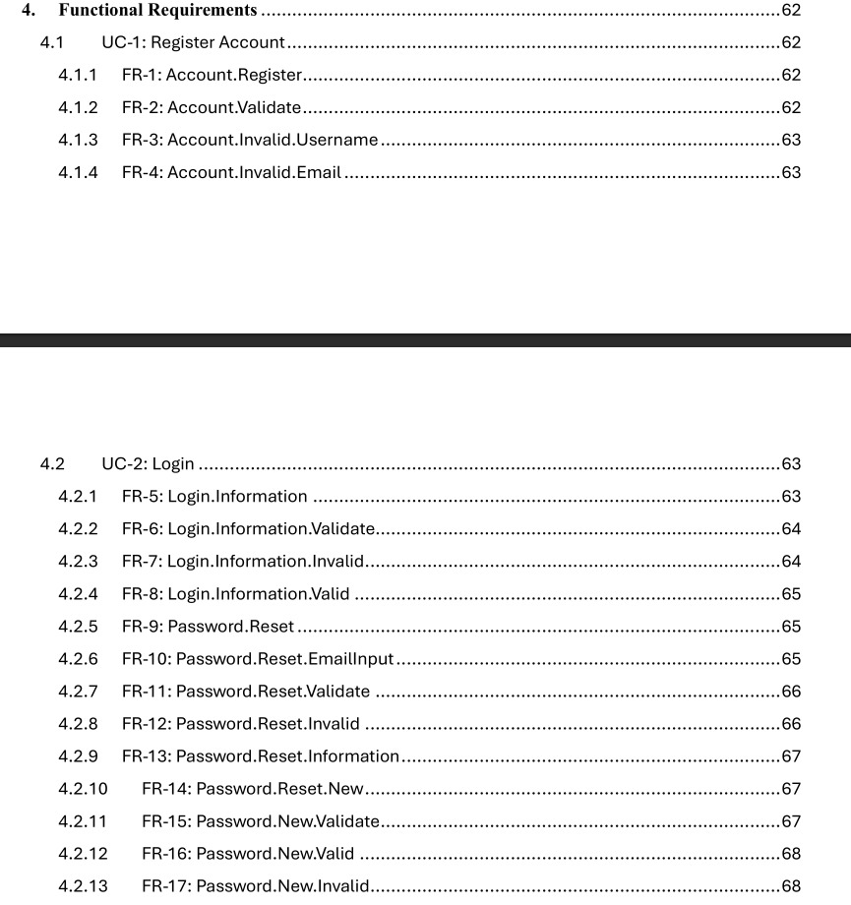

Slide 30
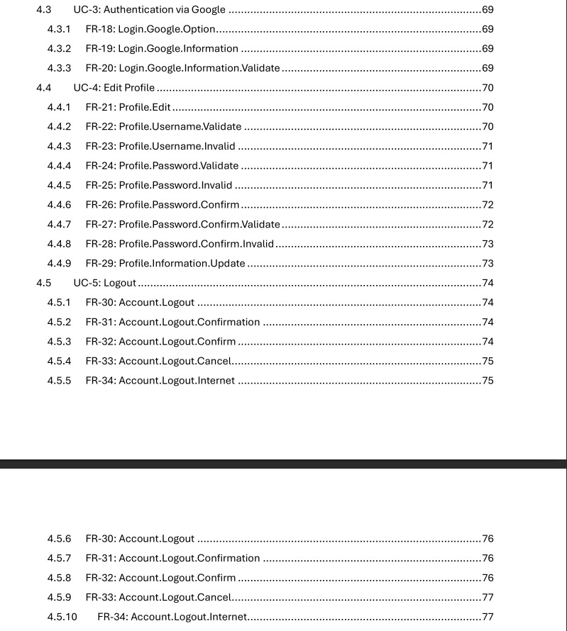

Slide 31
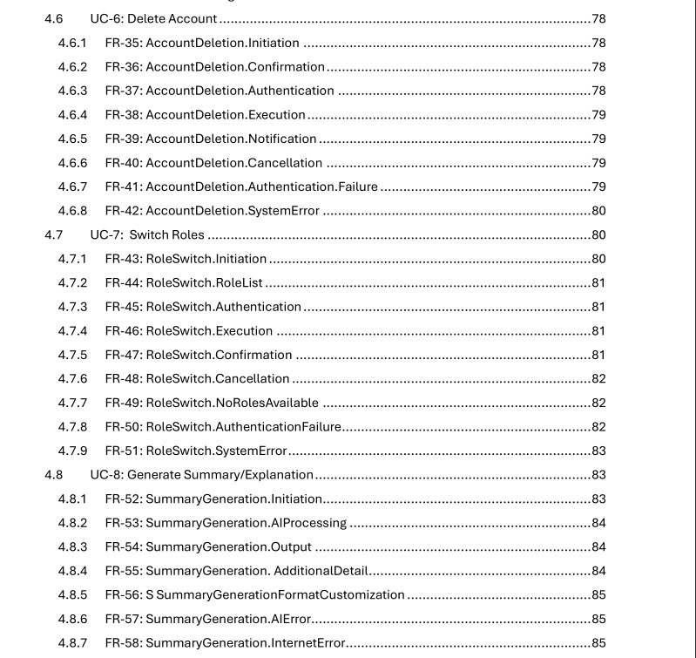

Slide 32
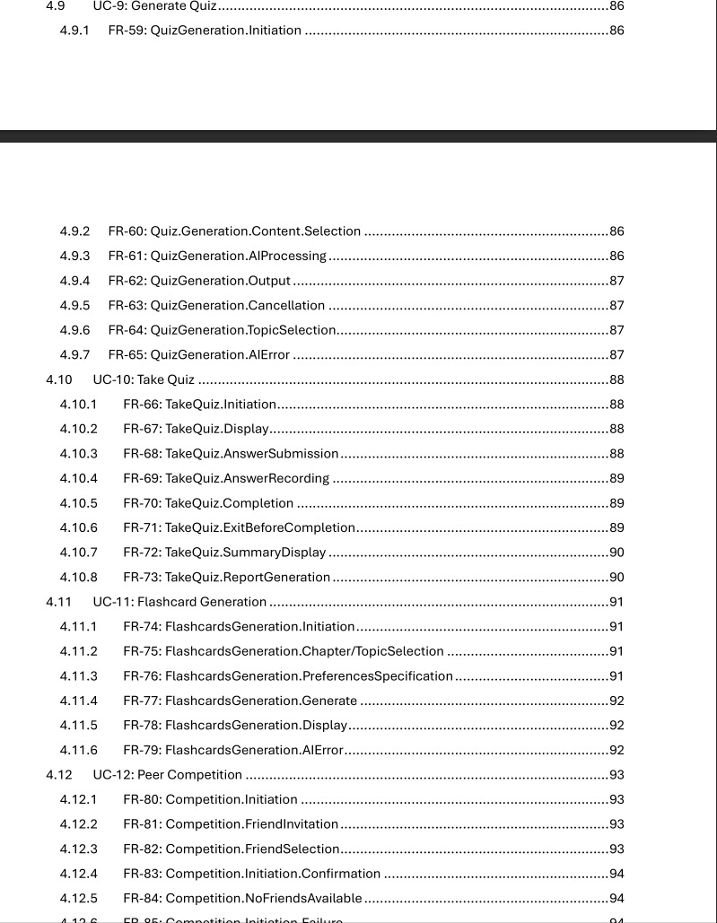

Slide 33
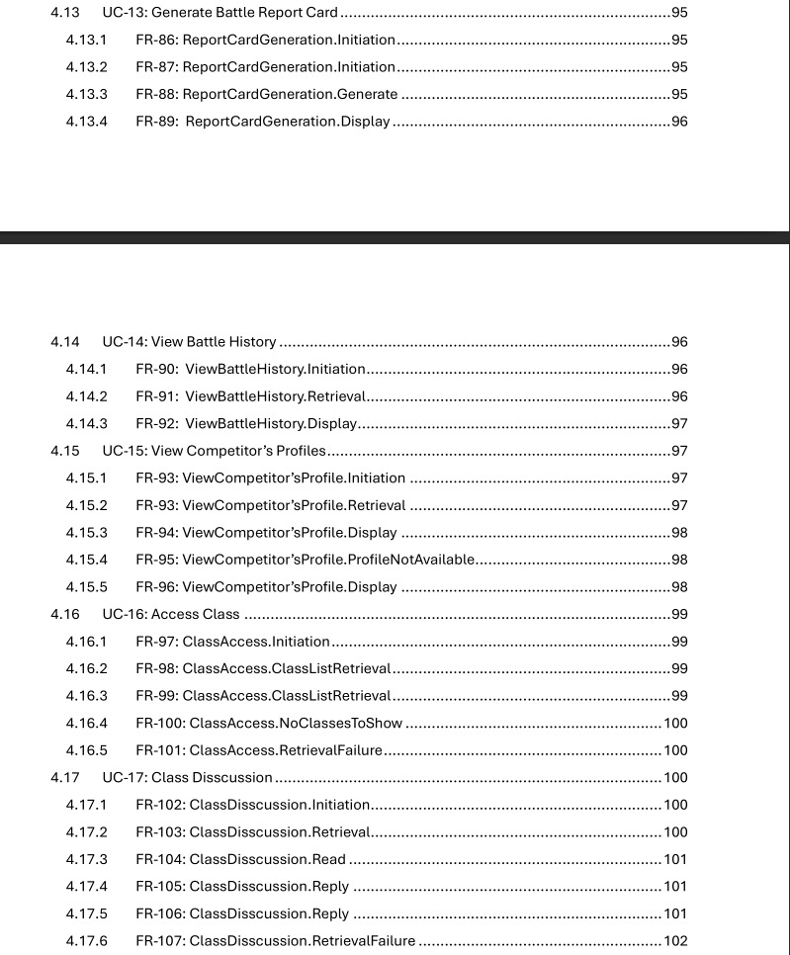

Slide 34
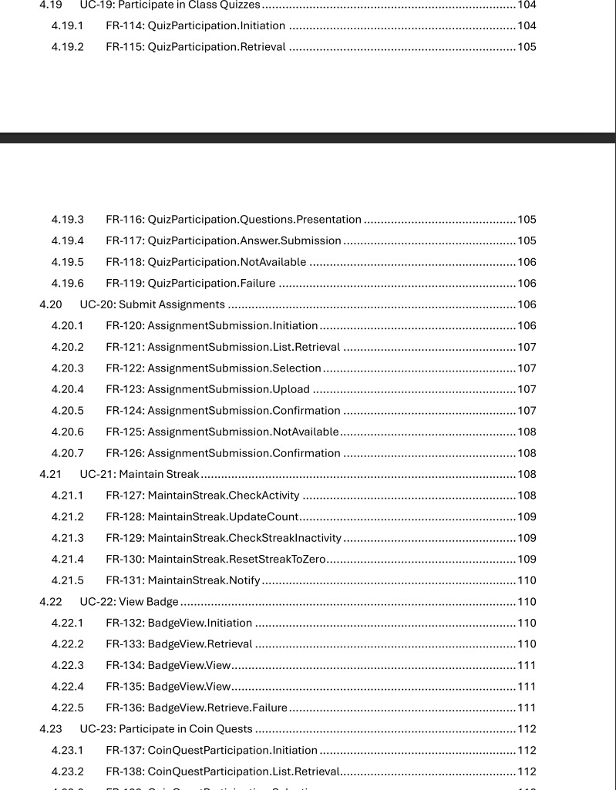

Slide 35
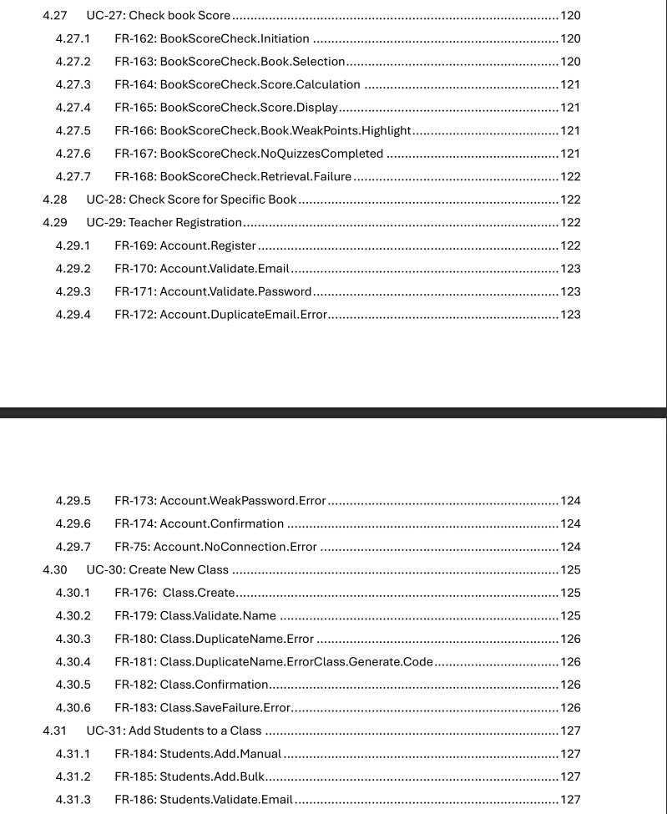

Slide 36
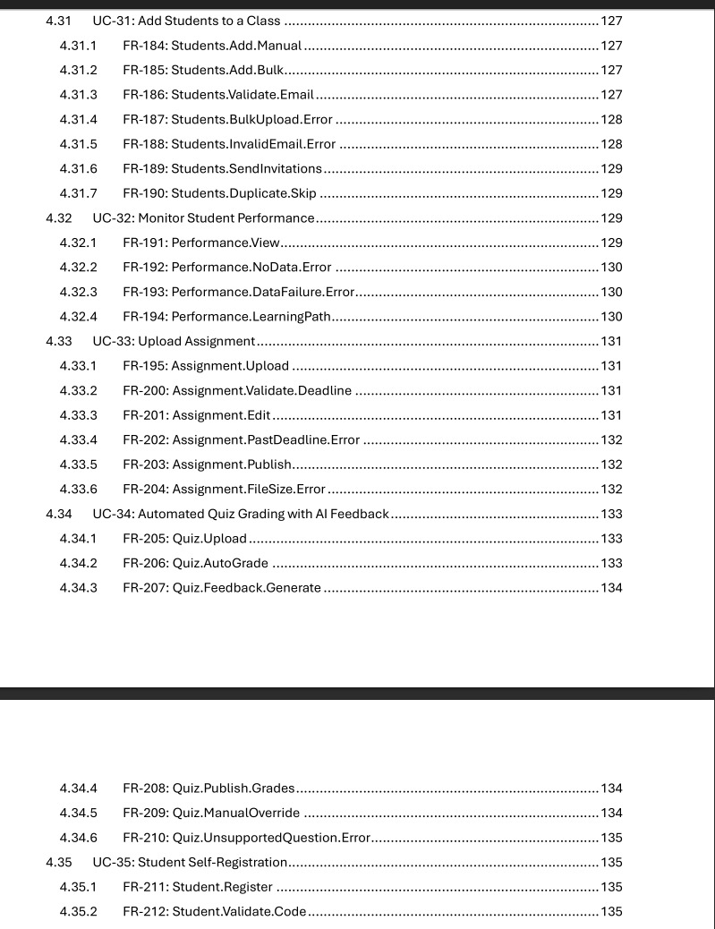

Slide 37
THANK YOU!

